Slide 1


Little Wandle: Letters and Sounds Revised
Parents Workshop

Slide 2
What is phonics?
Phonics is a way of teaching children how to read and write. It helps children hear, identify and use different sounds that distinguish one word from another in the English language.
Written language can be compared to a code, so knowing the sounds of individual letters and how those letters sound when they’re combined will help children decode words as they read.
Understanding phonics will also help children know which letters to use when they are writing words.

Slide 3
The alphabet and phonics
There are 26 letters in the alphabet BUT there are 44+ phonemes in the English language.
This does cause issues with reading and writing but with the correct phonic teaching by the end of KS1 children should be able decode and read using their phonic knowledge. This knowledge will then transfer into their writing.

Slide 4
Phonemes and Graphemes
We talk to our children about phonemes and graphemes.
Phonemes are the smallest single unit of sound heard in a word.
i.e in the word cat the phonemes are c-a-t.
Graphemes are the written representation of these sounds.
We refer to both of these as GPC – Grapheme Phoneme Correspondence.

Slide 5
Some phonemes are ‘bouncy sounds’. a, t, p, i, d
Some phonemes are ‘stretchy sounds’. s, n, m, f, l
It is important when we are modelling phonemes that we use pure sounds. This means when we say the phoneme ‘m’ we do not add ‘uh’ to the end ‘muh’. As this then makes it into 2 sounds m/u.

Slide 6
Phonics is split into 5 phases of learning.
Phase 1: taught in Nursery (no phonemes taught – focus on oral blending, speaking and listening)
Phase 2: taught in Reception (32 phonemes taught + double letters)
Phase 3: taught in Reception (14 phonemes taught)
Phase 4: taught in Reception (no phonemes taught – focus on blending longer words)
Phase 5: taught in Year 1 (alternative pronunciations of taught)
Children learning phonics in Year 2 Autumn term to consolidate their learning and start learning spelling patterns and rules.

Slide 7
Terminology
Please see our school website for a breakdown of the terminology used.
Phonemes
Graphemes
GPC
Diagraph
Trigraph
Split diagraph
cvc words (ccvc, ccvc…)
Adjacent consonants
Alien words (pseudo words)
Blending
Segmenting
‘chunk it up’
Compound word
Homograph
Homophone
Mnemonic
Oral blending
prefix
suffix
fluency
prosody
Comprehension
Spelling fingers

Slide 8
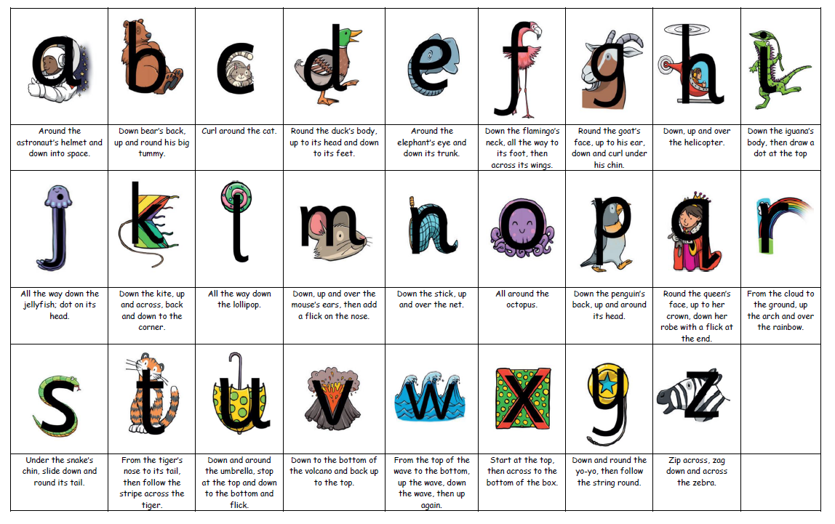
Formation phrase

Slide 9
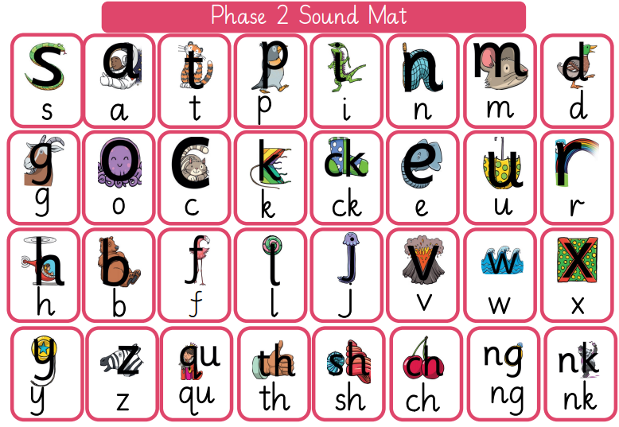
Phase 2

Slide 10
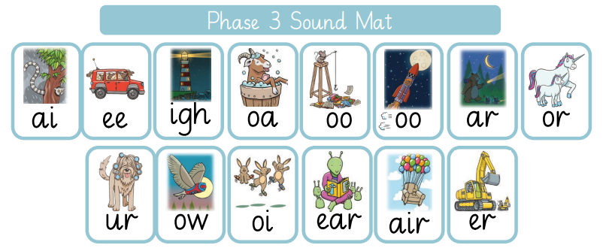
Phase 3

Slide 11
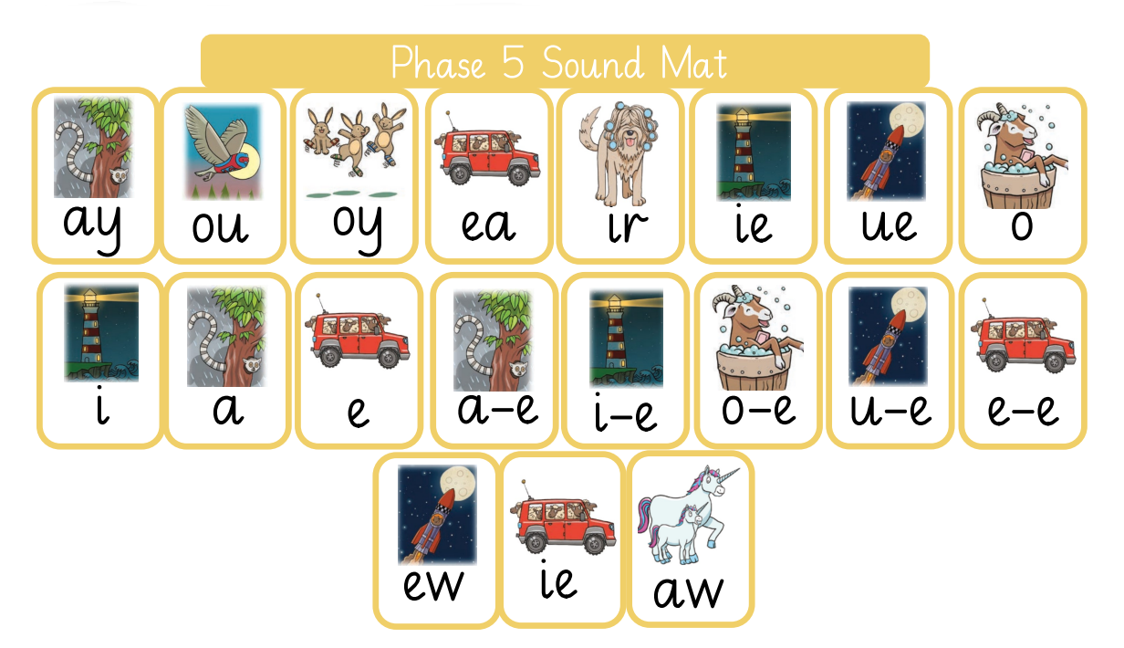
Phase 5

Slide 12
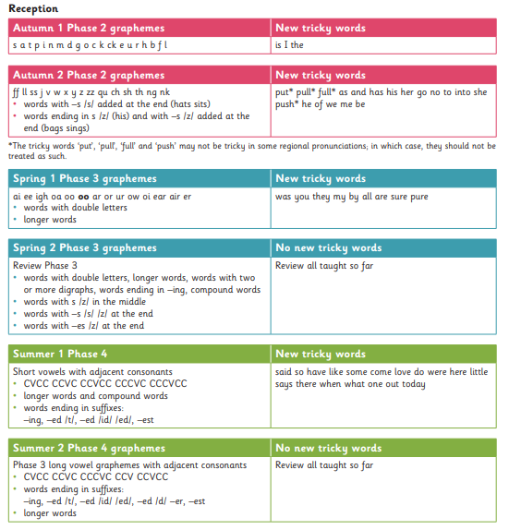
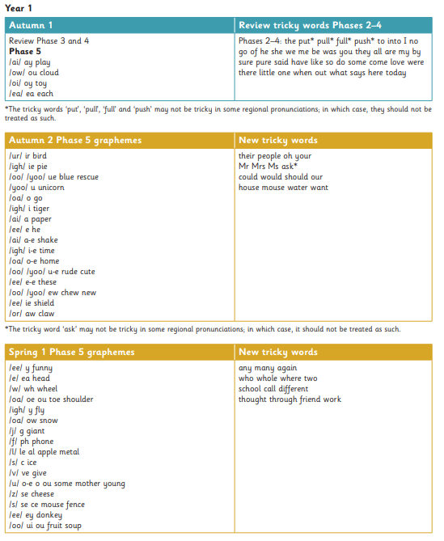

Slide 13
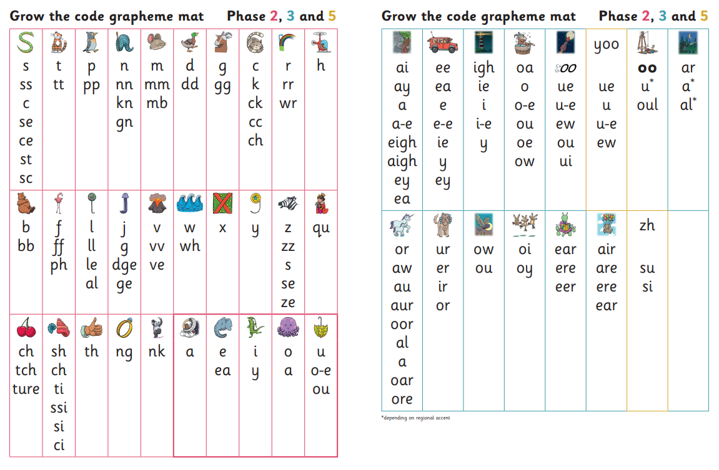
Grow the Code

Slide 14
For more support on the pronunciation of phonemes please see the PowerPoint on the class pages of our school website.

Slide 15
Blending and Segmenting
https://www.youtube.com/watch?v=IL5YUCPyC5I&list=PLuGr6z2H2KNFgREqlidDCLKfJC4KvaEfO&index=8
Blending is the process of putting together phonemes in order to read.
Segmenting is the process of breaking apart words in order to spell.
We teach both of these with sound buttons. Children are encourage to put sound buttons underneath their writing or put them down before writing a word. Dots are single phonemes and dashes are digraphs or trigraphs.
t
ch
ck
c
a
i

Slide 16
Tricky Words
https://www.youtube.com/watch?v=NTC0PbtmeUA&list=PLuGr6z2H2KNFgREqlidDCLKfJC4KvaEfO&index=7
Tricky words are words that are not decodable or may cause a difficultly depending on dialects.
Tricky words also cover Year 1 and Year 2 Statuary Common Exceptions words

Slide 17
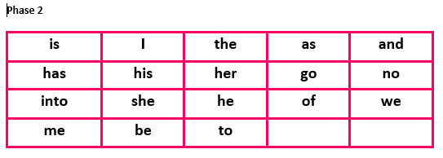
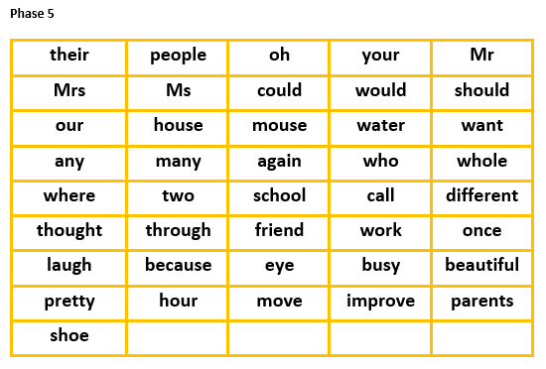
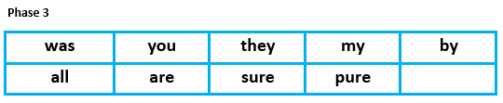
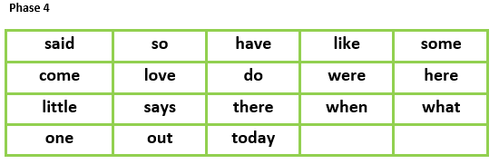
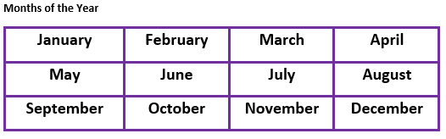
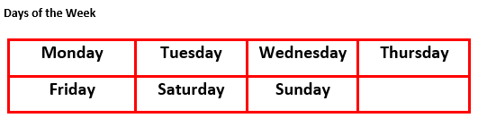

Slide 18
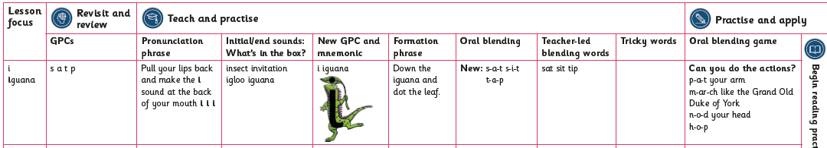
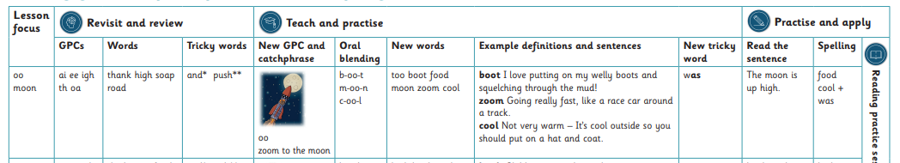
What does a phonics lesson look like?
Phonic lessons are 20 minutes long and are taught daily at 9.00am.
In reception, lessons start at 10 minutes and progress to 20 minutes.

Slide 19
Assessment and progression
At the end of each half term children are individually assessed upon the phonemes previously taught. These assessments help to highlight gaps in children’s learning. We can they fill these gaps with keep up phonic sessions which are undertaken by trained Teaching Assistants.
Assessments also play a key part in matching up reading books to individual phonic knowledge.

Slide 20
Reading Books
Reading lessons are 20 minutes long and are taught three times.
We follow a 3 day programme of reading:
Day 1 – decoding
Children look at focus sounds from the book and are introduced to key vocabulary.
Day 2 – prosody
Adults model sounding and blending, expression and fluency.
Day 3 – comprehension
Adults ask questions about the book to help draw out children’s understanding from their reading.
The half termly assessments help us to match reading books closely to your children ability so that they are never reading a book too easy or too hard for them. A child should be able to read a book at 90% fluency.
Reception will only get books once they can confidently blend 9 words. This is normally around the end of Autumn 1.
Reading books from Reading Lessons are kept in school. Big Cat reading books will be sent home Friday to Friday.

Slide 21
Sharing books
It is our job to teach reading to your child, so that you can share a love of stories and reading at home with your child.
Look at different genres eg, fiction or non-fiction. Don’t forget that magazines, newspapers and comics are also a form of reading!
Choose books that engage your child. What are they interested in?
Take it in turn to read a book, look at the pictures and discuss the meaning of words.
Visit the local library. They have a selection of books that can be easily assessed once children start blending. Just ask for the book banded reading books.
Remember to record the books that you are sharing at home so that we can discuss these at school and encourage others to read that book.
Let’s make reading FUN and not a chore!

Slide 22
Rapid Catch Up – Year 2 upwards
For children Year 2 upwards we run a daily intervention that aims to sufficiently catch pupils up with a short time frame.
Rapid Catch up is part of the Little Wandle Scheme.
Children are assessed and put in ability groups which can also be mixed year groups. These sessions are run by a trained TA.
Children will also have reading lessons and take home a reading book at their level.

Slide 23
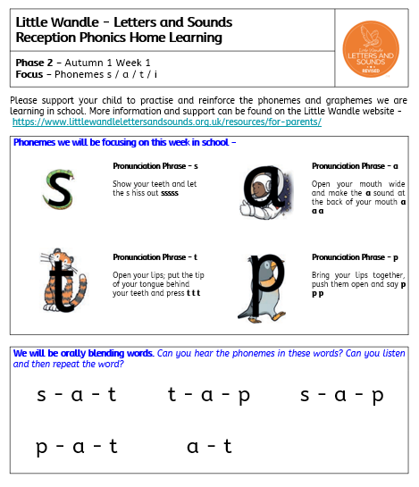
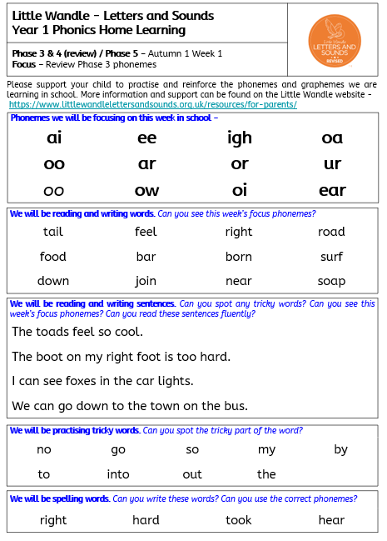
Home Learning
To consolidate children’s learning for the week we will post a home learning sheet onto Tapestry (or send home Yr 1 upwards).

Slide 24
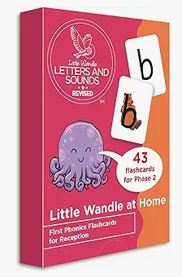
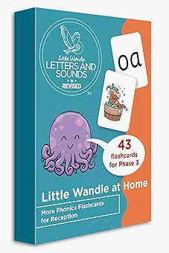
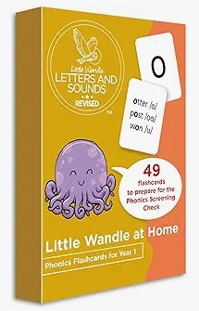
How can you help at home
Take a look on the Little Wandle website https://www.littlewandlelettersandsounds.org.uk/resources/for-parents/
Home learning sheets
Play games such as I spy, letter/sound hunts
Model reading and enjoy stories together! Don’t forget to revisit books
https://www.phonicsplay.co.uk/
Little Wandle at Home flash cards available from Amazon
Reading Eggs – online subscription.
Beware of workbooks aimed at teaching phonics. These can sometimes be confusing and complicated for children as they don’t follow a teaching pattern taught by accredited phonics schemes.

Slide 25
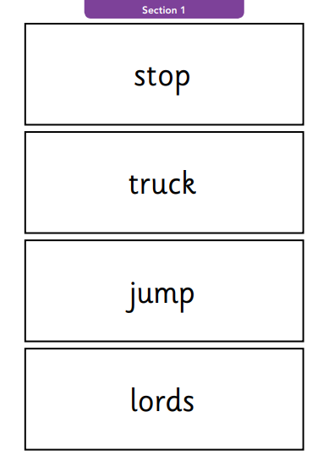
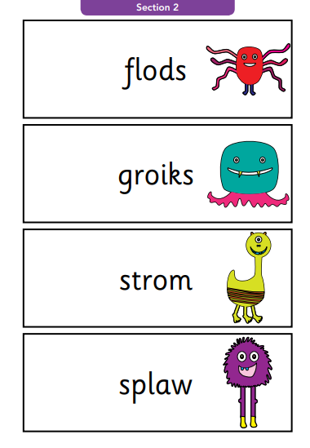
Phonic Screening Check
https://www.youtube.com/watch?v=VtoJZMVgy1I&list=PLuGr6z2H2KNFgREqlidDCLKfJC4KvaEfO&index=6
Taken in the Summer term of Year 1.
40 words consisting of 20 real and 20 ‘alien’ words that can be decoded using our phonic skills.
Pass mark is normally 32 out of 40.
For more information please see the Phonics Screening document on our school website.

Slide 26
Further Support
Email office@secfs.org.uk FAO Mrs Hayman
Talk to your class teachers
Class pages and Curriculum page on school website.
Tapestry documents (Reception)
https://www.littlewandlelettersandsounds.org.uk/resources/for-parents/

