Slide 1


Little Wandle: Letters and Sounds Revised
How to pronounce phonemes
Information for Parents

Slide 2
Phonemes and Graphemes
We talk to our children about phonemes and graphemes.
Phonemes are the smallest single unit of sound heard in a word.
i.e in the word cat the phonemes are c-a-t.
Graphemes are the written representation of these sounds.
We refer to both of these as GPC – Grapheme Phoneme Correspondence.

Slide 3
The alphabet and phonics
There are 26 letters in the alphabet BUT there are 44+ phonemes in the English language.
This does cause issues with reading and writing but with the correct phonic teaching by the end of KS1 children should be able decode and read using their phonic knowledge. This knowledge will them transfer into their writing.

Slide 4
Phonics is split into 5 phases of learning.
Phase 1: taught in Nursery (no phonemes taught – focus on oral blending, speaking and listening)
Phase 2: taught in Reception (32 phonemes taught + double letters)
Phase 3: taught in Reception (14 phonemes taught)
Phase 4: taught in Reception (no phonemes taught – focus on blending longer words)
Phase 5: taught in Year 1 (alternative pronunciations of taught)
Children may also continue learning phonics in Year 2 Autumn term to consolidate their learning.

Slide 5

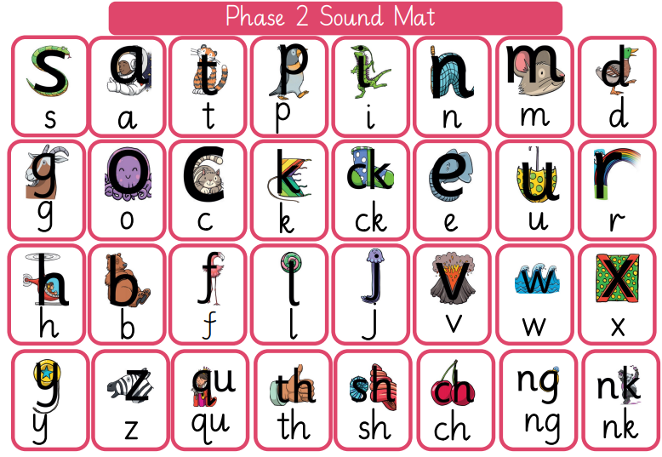
Phase 2

Slide 6



Slide 7



Slide 8



Slide 9



Slide 10



Slide 11



Slide 12



Slide 13
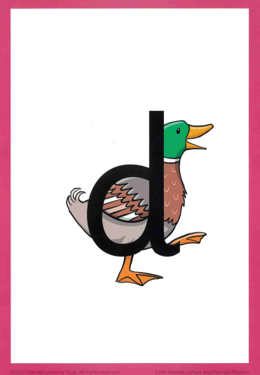


Slide 14



Slide 15



Slide 16



Slide 17



Slide 18



Slide 19



Slide 20



Slide 21



Slide 22



Slide 23



Slide 24



Slide 25



Slide 26



Slide 27



Slide 28



Slide 29



Slide 30



Slide 31



Slide 32



Slide 33



Slide 34



Slide 35



Slide 36



Slide 37



Slide 38





Slide 39
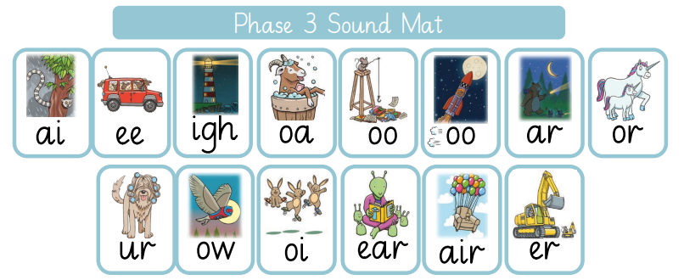
Phase 3

Slide 40

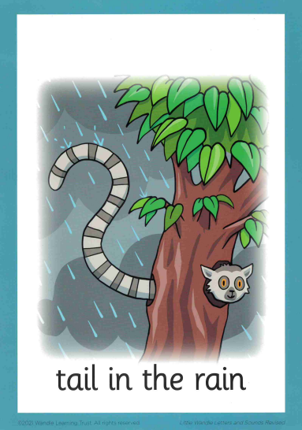

Slide 41

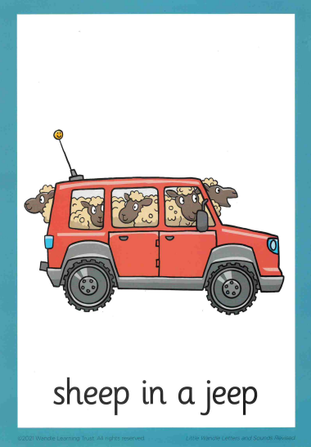

Slide 42



Slide 43

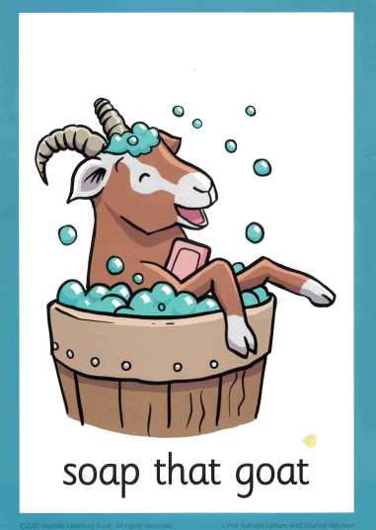

Slide 44

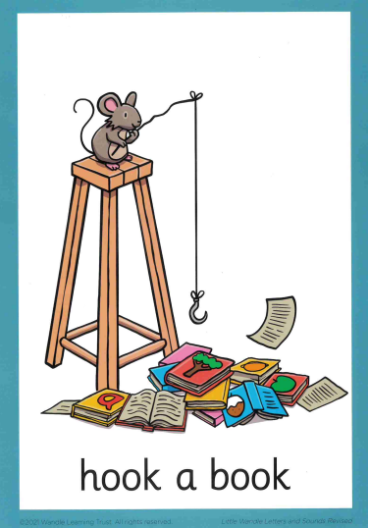

Slide 45



Slide 46



Slide 47

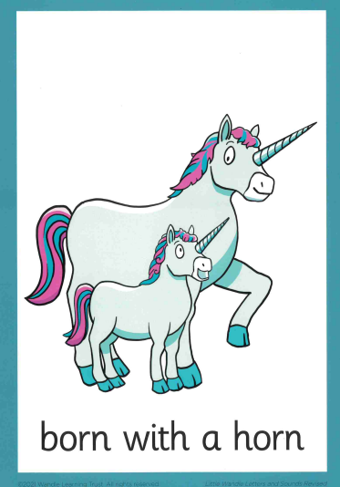

Slide 48



Slide 49



Slide 50

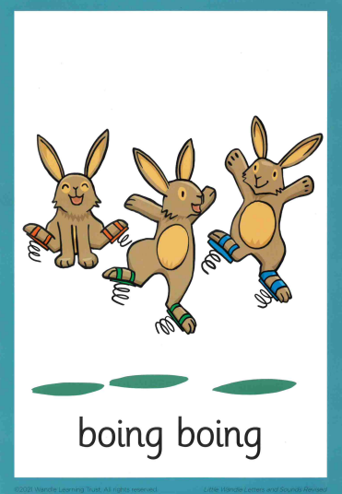

Slide 51



Slide 52

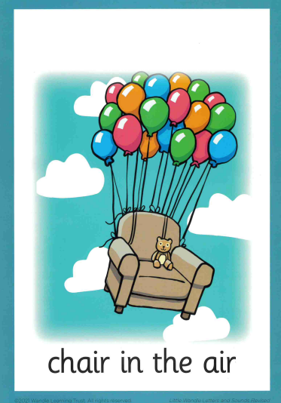

Slide 53



Slide 54
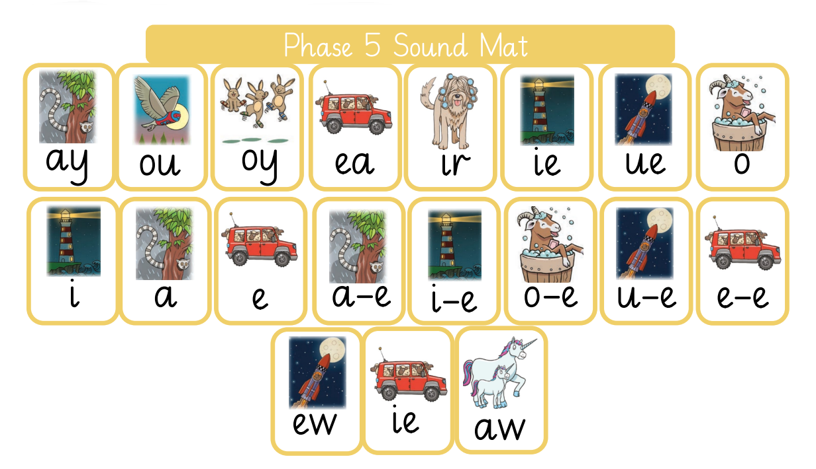
Phase 5

Slide 55
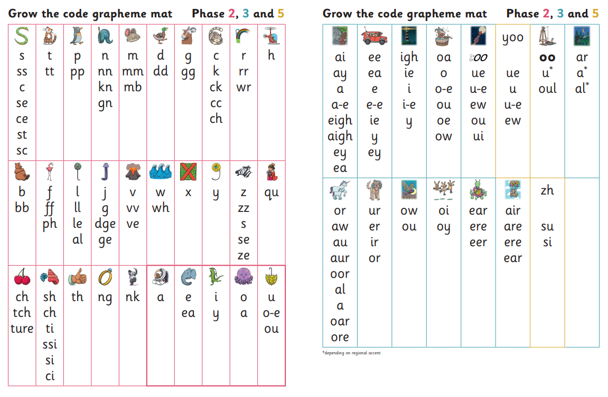
Grow the Code

Slide 56
Further Support
Email office@secfs.org.uk FAO Mrs Hayman
Class pages on school website.
Parents workshop information session TBC
Parents workshop powerpoint on school website
Tapestry documents (Reception & Year 1)
https://www.littlewandlelettersandsounds.org.uk/resources/for-parents/

